Slide 1
Different Impact Cases

Slide 2
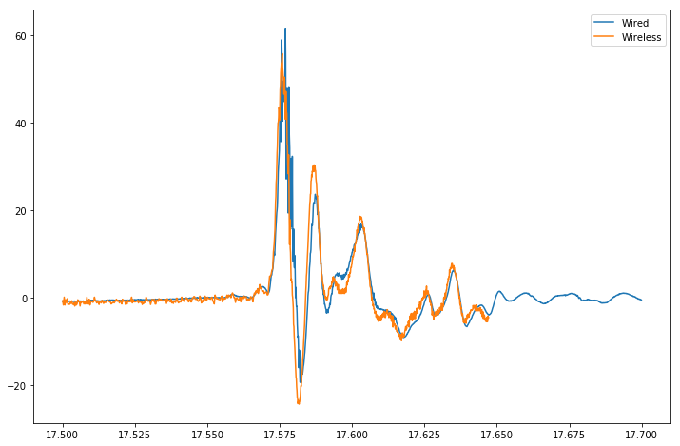
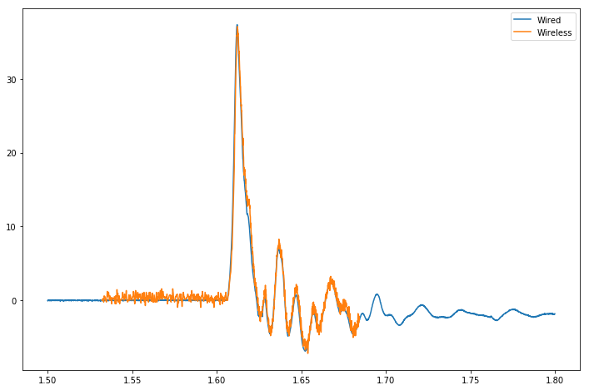
Both sensors together – Normal

Slide 3
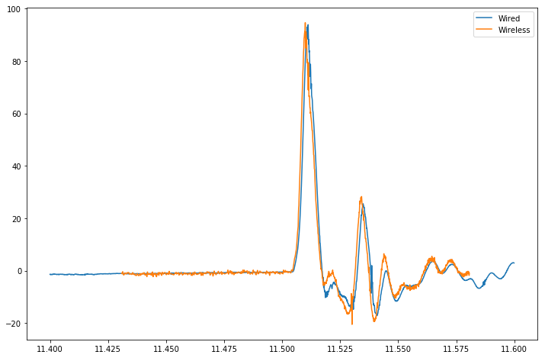
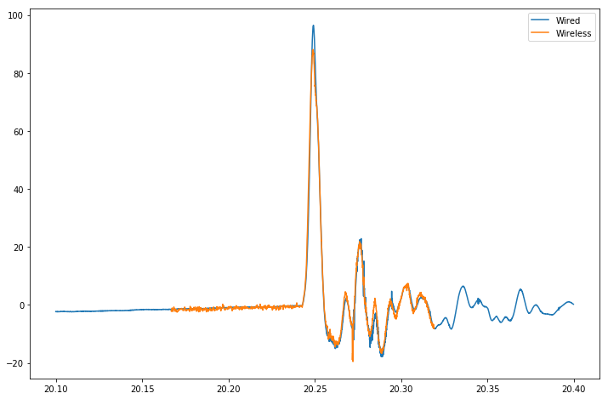
Both Sensors Together – Off-Center Impacts

Slide 4
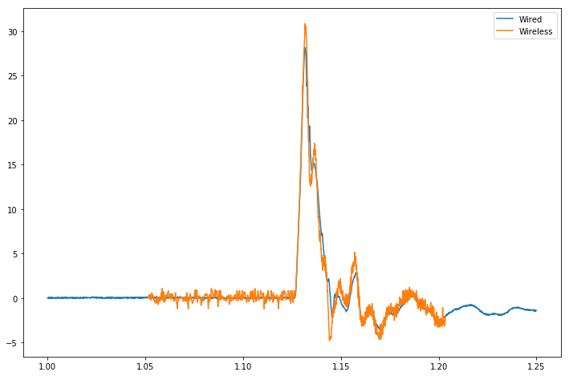
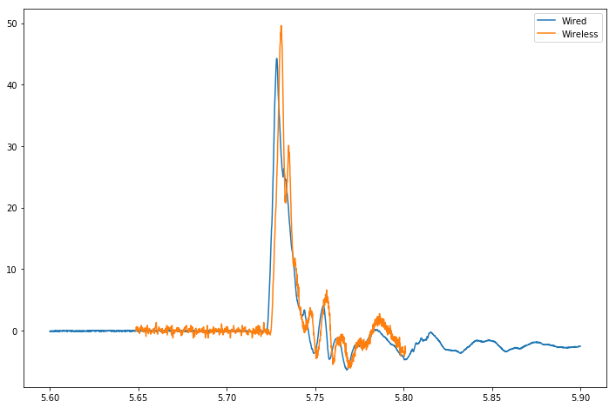
Cabled Sensor Under Helmet Wireless Sensor Banded Over Helmet

Slide 5
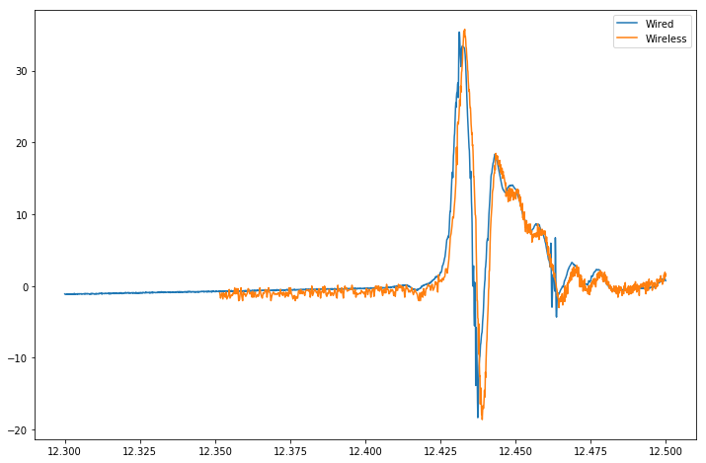
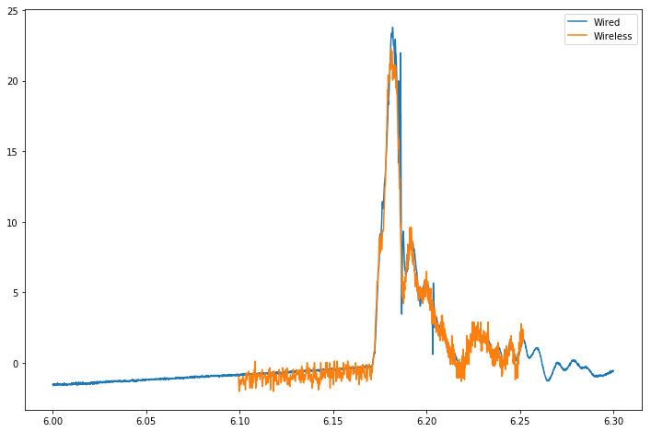
Cabled Sensor Under Helmet Wireless Sensor Taped Over Helmet

